Slide 1
Car Price Prediction Using Machine Learning
Created by-Sujay Nimbalkar
Submitted to-Swati Mahaseth
FlipRobo Technologies

Slide 2


Slide 3
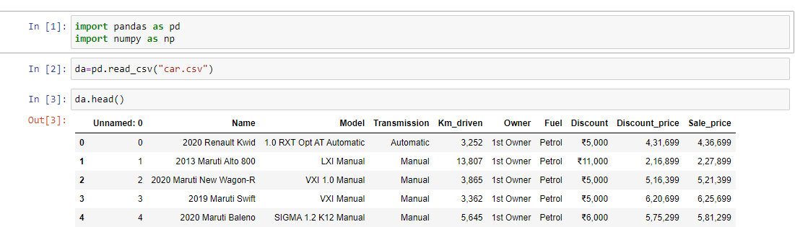
Importing libraries

Slide 4
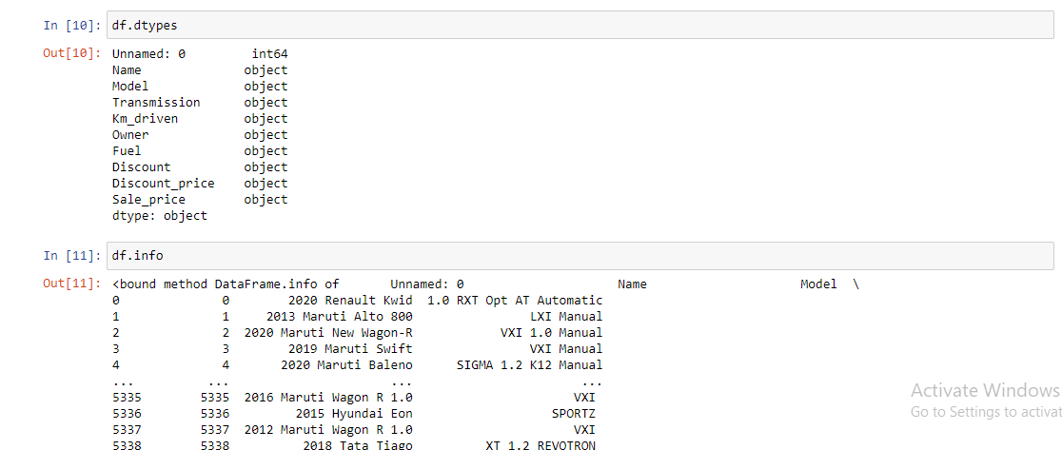
Checking the Df Types and Info

Slide 5
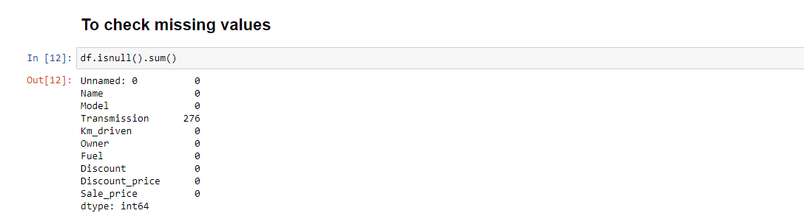
Checking the Missing Values

Slide 6
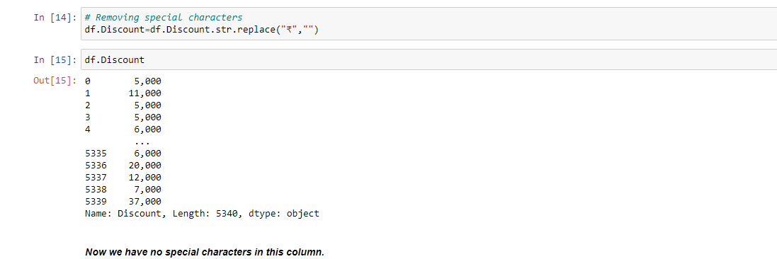
Removal of Special Characters

Slide 7
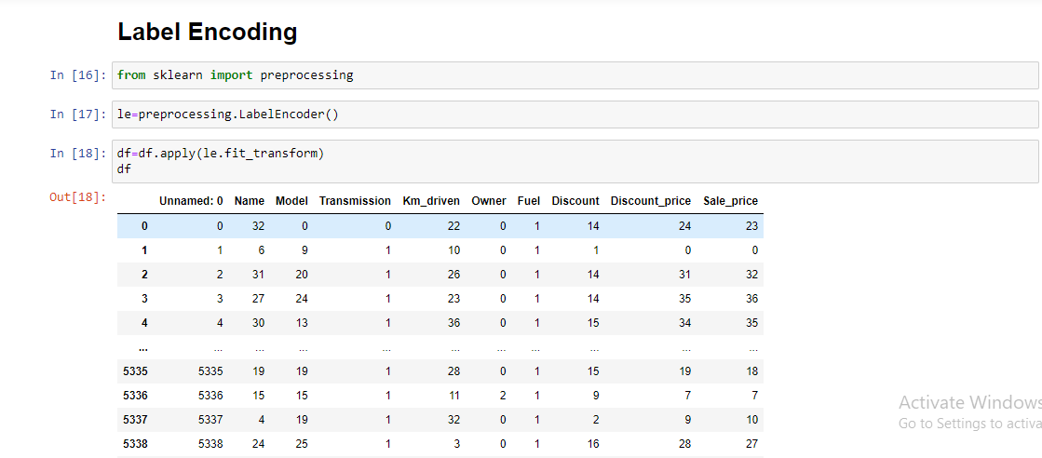
Applying Label Encoder as many columns are in string format

Slide 8
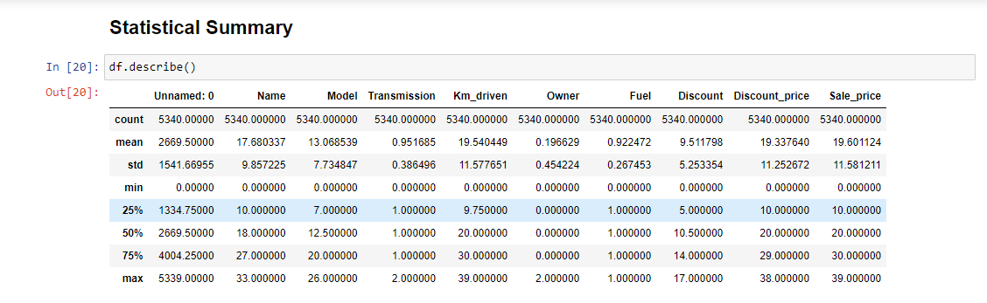
Statistical Summary

Slide 9
Major observations
1 The difference in mean and median is almost similar.
2 From the count we can see that we have no missing values.
3 We can see that we have small difference in 75% percentile and max in columns like Name, Model, Km_driven,Discount, Discount_price, Sale_Price.

Slide 10
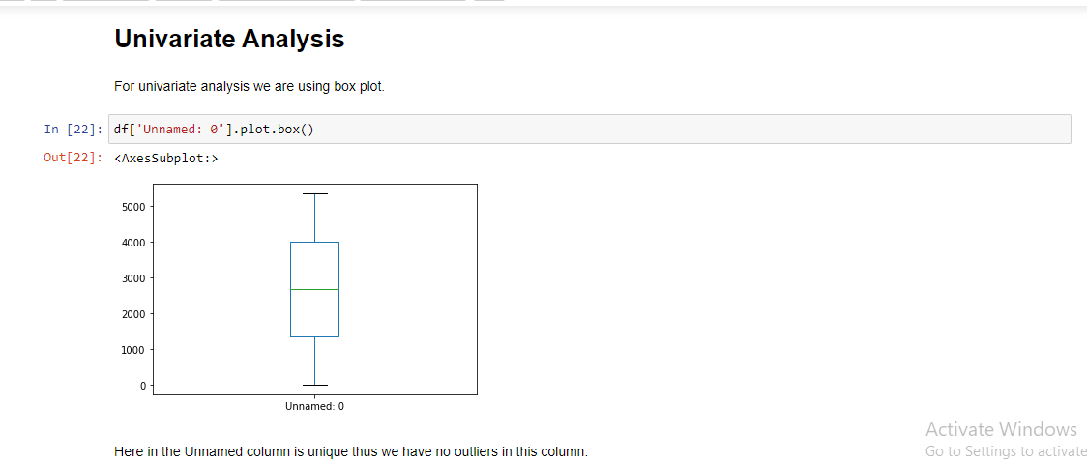
Unvariate Analysis using box plots

Slide 11
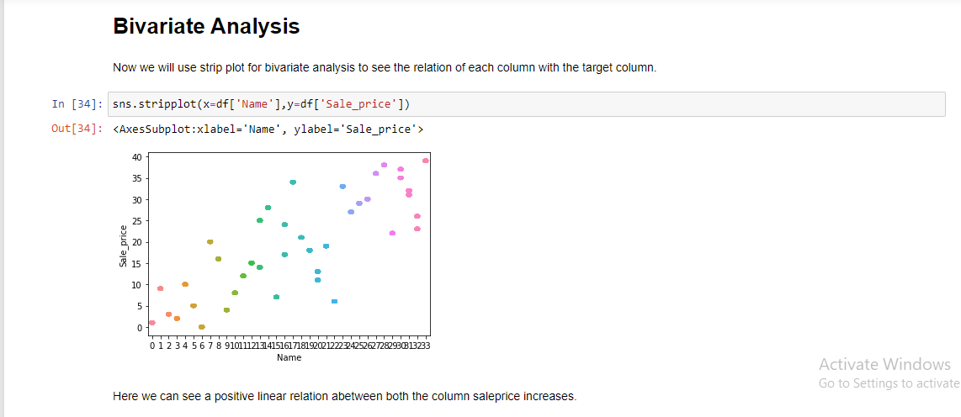
Bivariate Analysis use strip plot for bivariate analysis to see the relation of each column with the target column.

Slide 12
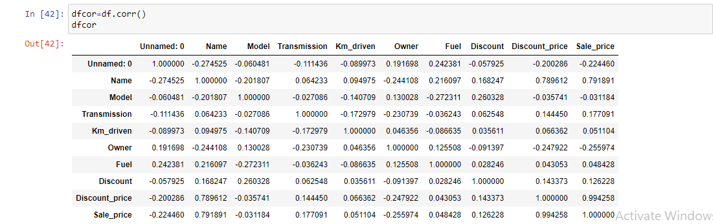
Multivariate analysis To check the co -relation

Slide 13
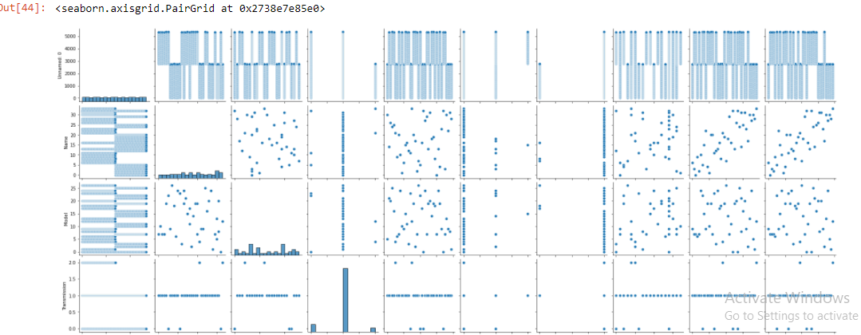
Pair Plots

Slide 14
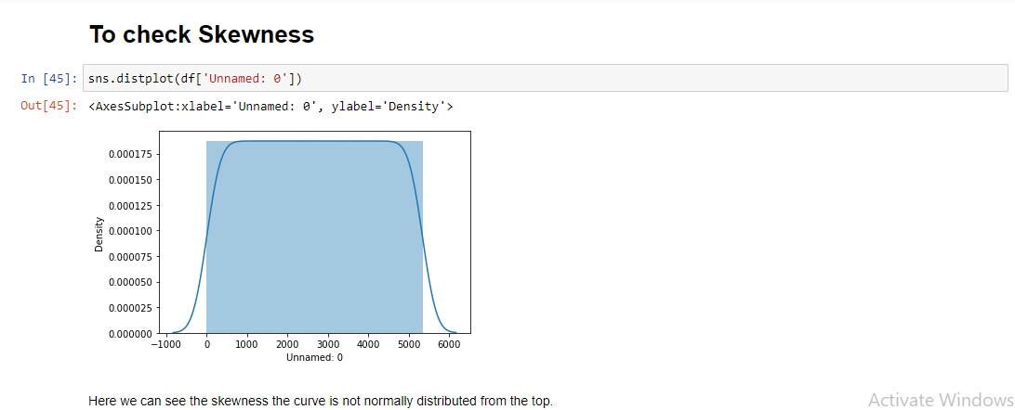
Checking The Skewness

Slide 15
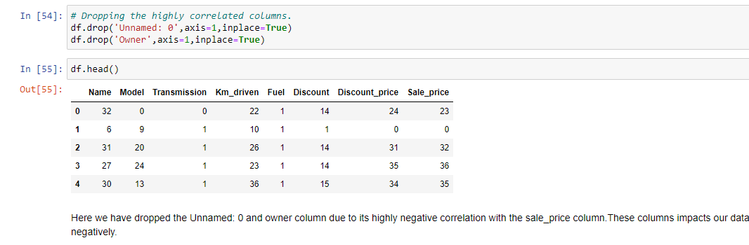
Data Cleaning

Slide 16
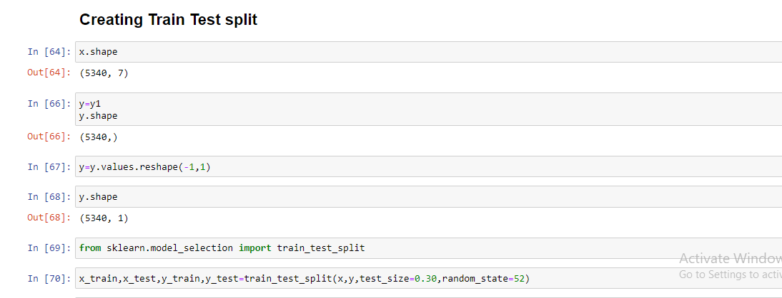
Using Train-Test-Split Function

Slide 17
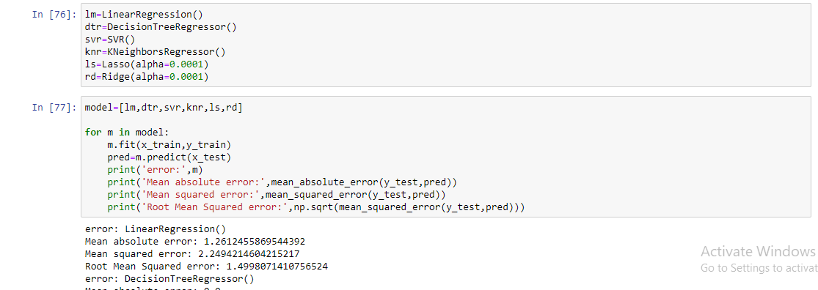
Finding the best Model All togeather

Slide 18
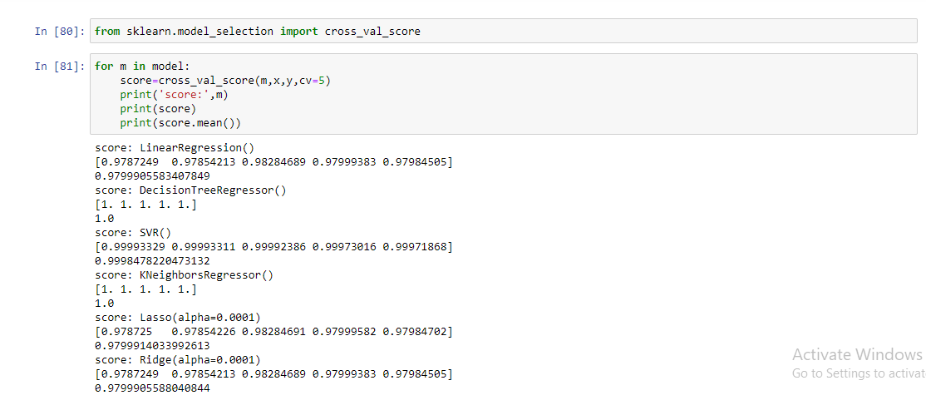
Doing cross-validation

Slide 19
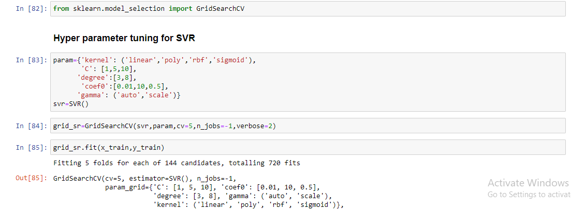
Performing Hyper Parameter Tuning for svr

